Slide 1
The Rich Data Controls

Slide 2
The Rich Data Controls
Rich data controls that support repeated-value binding
Rich data controls include the following
GridView
DetailsView
FormView
ListView

Slide 3
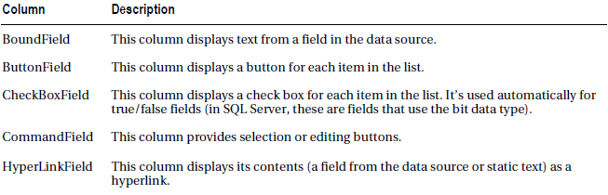
The GridView
Shows data in a basic grid consisting of rows and columns
Features include selection, paging, sorting, and editing, and it is extensible through templates
Defining Columns
Set GridView.AutoGenerateColumns property to false
Define the columns in the <Columns> section

Slide 4
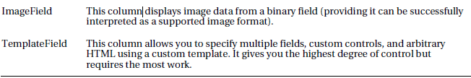
Column Types

Slide 5
BoundField, which binds to one field in the data object
A single data-bound column that displays the EmployeeID field
<asp:BoundField DataField="EmployeeID" HeaderText="ID" />

Slide 6
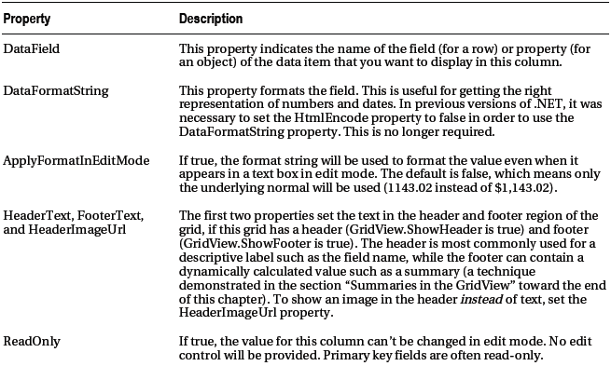

Slide 7
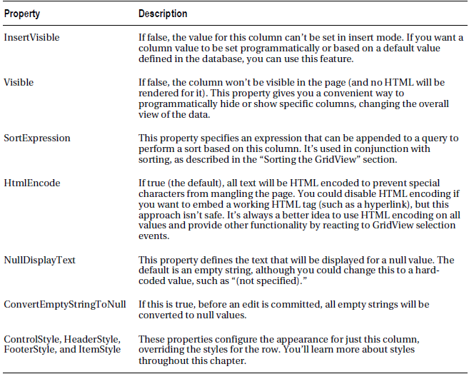

Slide 8
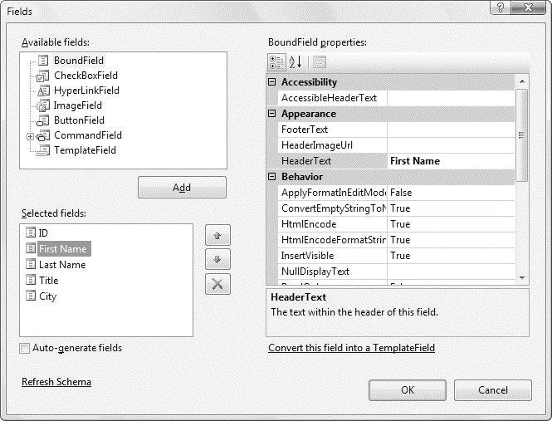
Configuring columns in Visual Studio

Slide 9
Formatting the GridView
DataFormatString property
Styles
Intercept events, examine row data, and apply formatting to specific data points programmatically
Other properties:-
GridLines (for adding or hiding table borders),
CellPadding and CellSpacing (for controlling the overall spacing between cells)
Caption and CaptionAlign (for adding a title to the top of the grid).

Slide 10
Formatting Fields
Use format string to configure the appearance of numbers and dates
{0:C}
The 0 represents the value that will be formatted, and the letter indicates a predetermined format style
C means currency format
<asp:BoundField DataField="UnitPrice" HeaderText="Price“ DataFormatString="{0:C}" />

Slide 11
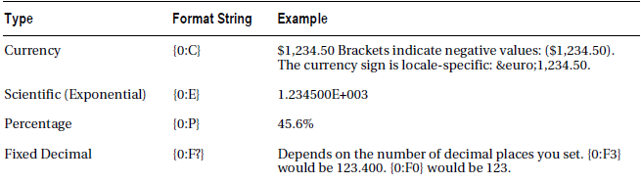
Numeric Format Strings

Slide 12
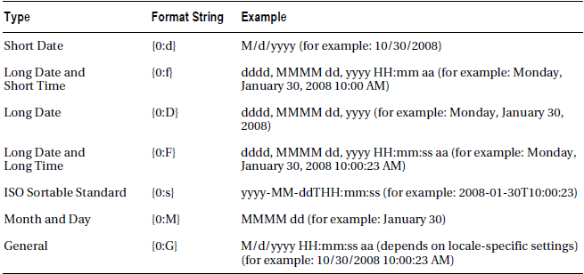
Time and Date Format Strings
<asp:BoundField DataField="BirthDate" HeaderText="Birth Date“ DataFormatString="{0:MM/dd/yy}" />

Slide 13
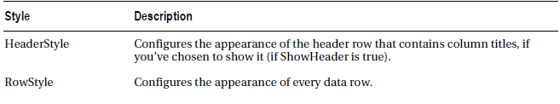
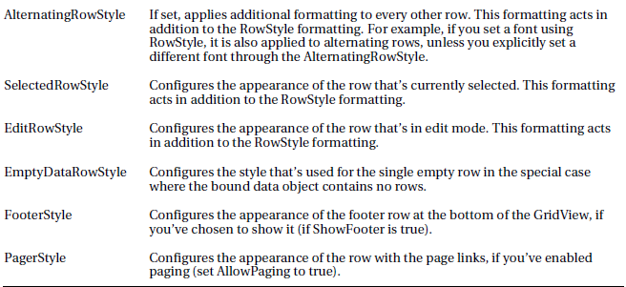
Styles
There are eight GridView styles

Slide 14
Defining Styles
indicate the extended style properties as attributes in the opening tag for the GridView
<asp:GridView runat="server" ID="grid"
RowStyle-ForeColor="DarkBlue" ... />
...
</asp:GridView>
Or
Adding nested tags
<asp:GridView runat="server" ID="grid" ...>
<RowStyle ForeColor="DarkBlue" ... />
...
</asp:GridView>

Slide 15
To create a column-specific style, you need to add style attributes or a nested tag inside the appropriate column tag
<asp:GridView runat="server" ID="grid" ...>
<Columns>
<asp:BoundField DataField="EmployeeID" HeaderText="ID" ItemStyle-Width="30px" />
...
</Columns>
</asp:GridView>
Or
<asp:GridView runat="server" ID="grid" ...>
<Columns>
<asp:BoundField DataField="EmployeeID" HeaderText="ID">
<ItemStyle Width="30px" />
</asp:BoundField>
...
</Columns>
</asp:GridView>

Slide 16
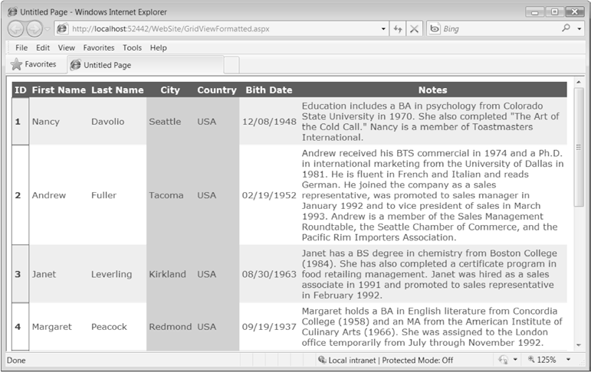
A formatted GridView

Slide 17
Formatting-Specific Values
React to the GridView.RowDataBound event
Access the current row as a GridViewRow control
GridViewRow.DataItem property provides the data object for the given row
GridViewRow.Cells collection allows you to retrieve the row content

Slide 18
Example
The item’s background color is set to pink and the foreground color is set to maroon if the title of courtesy is a title for a female—in this case Ms. or Mrs.
The item’s background color is set to dark blue and the foreground color is set to light cyan if the title of courtesy is Mr.
For other generic titles such as Dr., the item is rendered with the background color specified by the GridView.BackColor property.

Slide 19
Example of Code-behind
Protected Sub gridEmployees_RowDataBound(
ByVal sender As Object, ByVal e As System.Web.UI.WebControls.GridViewRowEventArgs
) Handles gridEmployees.RowDataBound
If e.Row.RowType = DataControlRowType.DataRow Then
' Get the title of courtesy for the item that's being created.
Dim title As String =
DirectCast(DataBinder.Eval(e.Row.DataItem, "TitleOfCourtesy"), String)
' If the title of courtesy is "Ms.", "Mrs.", or "Mr.",
' change the item's colors.
If title = "Ms." OrElse title = "Mrs." Then
e.Row.BackColor = System.Drawing.Color.LightPink
e.Row.ForeColor = System.Drawing.Color.Maroon
ElseIf title = "Mr." Then
e.Row.BackColor = System.Drawing.Color.LightCyan
e.Row.ForeColor = System.Drawing.Color.DarkBlue
End If
End If
End Sub

Slide 20
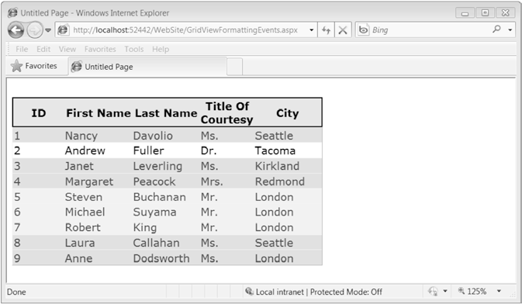
Formatting individual rows based on values

Slide 21
GridView Row Selection
Add a CommandField column with the ShowSelectButton property set to true
CommandField can be rendered as a hyperlink, a button, or a fixed image through the ButtonType property
Specify the text through the SelectText property
Specify the link to the image through the SelectImageUrl property
<asp:CommandField ShowSelectButton="True" ButtonType="Button“ SelectText="Select" />
<asp:CommandField ShowSelectButton="True" ButtonType="Image“ SelectImageUrl="select.gif" />
When the select button is clicked, the page is posted back, and a series of steps unfolds.
First, the GridView.SelectedIndexChanging event fires
Next, the GridView.SelectedIndex property is adjusted to point to the selected row
Finally, the GridView.SelectedIndexChanged event fires, which lets you manually update other controls to reflect the new selection
When the page is rendered, the selected row is given the SelectedRowStyle

Slide 22
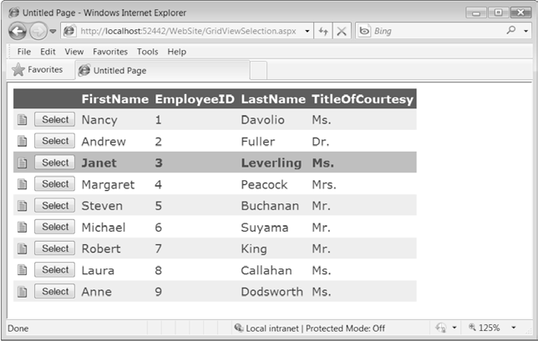
GridView selection

Slide 23
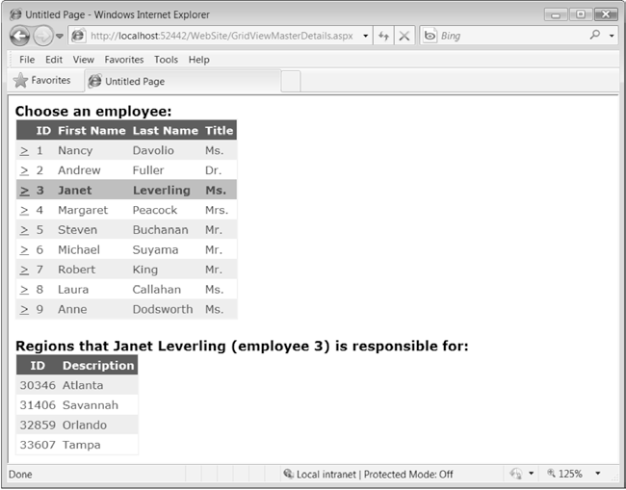
Using Selection to Create a Master-Details Form

Slide 24
The SelectedIndexChanged Event
React to the SelectedIndexChanged event to redirect the user to a new page (possibly with the selected value in the query string) or to add a label describing the child table
Protected Sub gridEmployees_SelectedIndexChanged( ByVal sender As Object, ByVal e As System.EventArgs) Handles gridEmployees.SelectedIndexChanged
Dim index As Integer = gridEmployees.SelectedIndex
' You can retrieve the key field from the SelectedDataKey property.
Dim ID As Integer = CInt(gridEmployees.SelectedDataKey.Values("EmployeeID"))
' You can retrieve other data directly from the Cells collection,
' as long as you know the column offset.
Dim firstName As String = gridEmployees.SelectedRow.Cells(2).Text
Dim lastName As String = gridEmployees.SelectedRow.Cells(3).Text
lblRegionCaption.Text = "Regions that " & firstName & " " & lastName &
" (employee " & ID.ToString() & ") is responsible for:"
End Sub

Slide 25
Using a Data Field As a Select Button
Can turn an existing column into a link
Add a ButtonField column and set the DataTextField to the name of the field you want to use.
<asp:ButtonField ButtonType="Button“ DataTextField="EmployeeID" />
This field will be underlined and turned into a link that, when clicked, will post back the page and trigger the GridView.RowCommand event
Or
Configure the link to raise the SelectedIndexChanged event by specifying a CommandName with the text Select
<asp:ButtonField CommandName="Select" ButtonType="Button“ DataTextField="EmployeeID" />
Clicking the data field automatically selects the record

Slide 26
Sorting the GridView
Allows the user to reorder the results in the GridView by clicking a column header
Must set the GridView.AllowSorting property to true
Define a SortExpression for each column that can be sorted
The sort expression can include a single field or a list of comma-separated fields
Add the word ASC or DESC after the column name to sort in ascending or descending order
<asp:BoundField DataField="FirstName“ HeaderText="First Name“ SortExpression="FirstName"/>
It’s up to the data source control to implement the actual sorting logic

Slide 27
Sorting with the SqlDataSource
Sorting is performed using the built-in sorting capabilities of the DataView class
The DataView.Sort property is set to the sorting expression for that column
Without DataView sorting, a separate query is needed to retrieve the newly sorted data

Slide 28
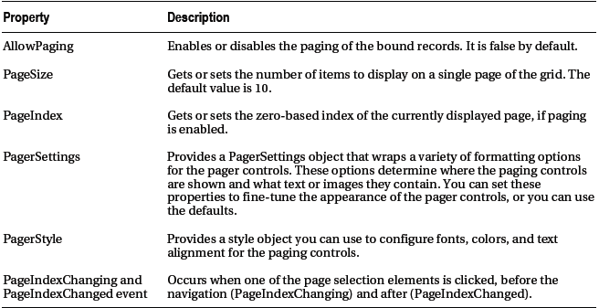
Paging the GridView
Built-in support for pagination
Automatic Paging
set AllowPaging to true
set PageSize to determine how many rows are allowed on each page (default is 10)
Paging Members of the GridView

Slide 29
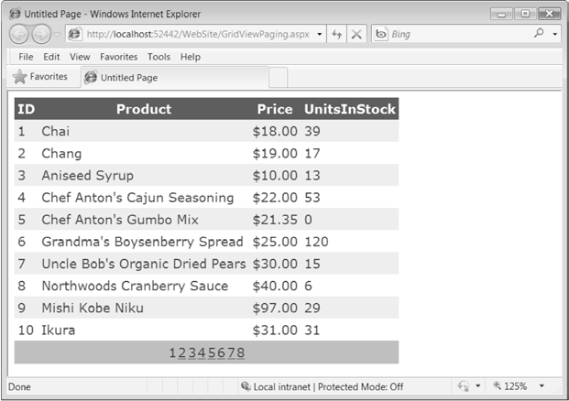
<asp:GridView ID="GridView1" runat="server" DataSourceID="sourceEmployees“ PageSize="5" AllowPaging="True" ...>
...
</asp:GridView>
Paging 10 records at a time

Slide 30
Customizing the Pager Bar
customize them thoroughly using the PagerStyle property (for foreground and background colors, the font, color, size, and so on) and the PagerSettings property
<asp:GridView ID="GridView1" runat="server" DataSourceID="sourceProducts"
AllowPaging="True" ...>
<PagerSettings Mode="NextPrevious" PreviousPageText="< Back"
NextPageText="Forward >" />
<PagerStyle BackColor="#FFCC66" ForeColor="#333333"
HorizontalAlign="Center" />
...
</asp:GridView>

Slide 31
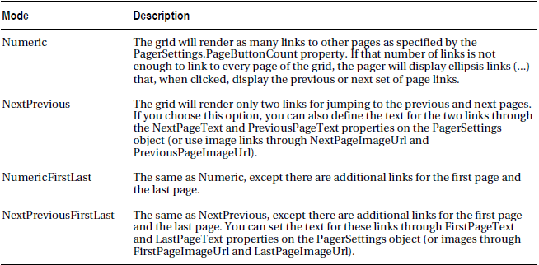
Pager Modes

Slide 32
GridView Templates
Allows to define a completely customized template for a column
Create a column that combines the first name, last name, and courtesy fields
<asp:TemplateField HeaderText="Name">
<ItemTemplate>
<%# Eval("TitleOfCourtesy") %> <%# Eval("FirstName") %>
<%# Eval("LastName") %>
</ItemTemplate>
</asp:TemplateField>
The Eval method automatically retrieves the data item that’s bound to the current row, uses reflection to find the matching field (for a DataRowobject) or property (for a custom data object), and retrieves the value
Without the Eval() method, you’d need to access the data object through the Container.DataItem property and use typecasting code like this
<%# ((EmployeeDetails)Container.DataItem)["FirstName"] %>

Slide 33
Eval() method has the ability to format data fields on the fly
<%# Eval("BirthDate", "{0:MM/dd/yy}") %>

Slide 34
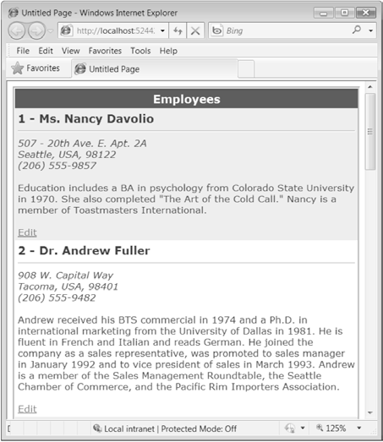
Creating a templated column

Slide 35
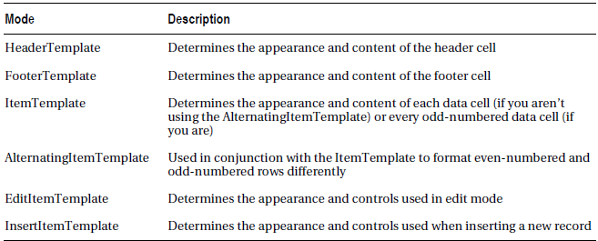
Using Multiple Templates
GridView templates
Two templates that can be used outside of any column
PagerTemplate (to customize the appearance of pager controls)
EmptyDataTemplate (to set the content that should appear if the GridView is bound to an empty data object)

Slide 36
Binding to a Method
Ability to incorporate dynamic information and conditional logic
Example, display check marks indicate when there is a large quantity of a given item in stock (more than 50 units) and an X indicates when stock is fully depleted
<asp:TemplateField HeaderText="Status">
<ItemTemplate>
<img src='<%# GetStatusPicture(Container.DataItem) %>' alt="Status" />
</ItemTemplate>
</asp:TemplateField>

Slide 37
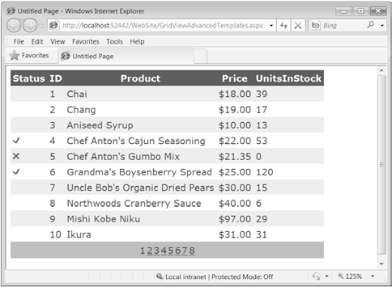
Flagging rows conditionally

Slide 38
GetStatusPicture() method
Protected Function GetStatusPicture(ByVal dataItem As Object
) As String
Dim units As Integer =
Int32.Parse(DataBinder.Eval(dataItem, "UnitsInStock").ToString())
If units = 0 Then
Return "Cancel.gif"
ElseIf units > 50 Then
Return "OK.gif"
Else
Return "blank.gif"
End If
End Function

Slide 39
Handling Events in a Template
To create a clickable image link through the ImageButton control
<asp:TemplateField HeaderText="Status">
<ItemTemplate>
<asp:ImageButton ID="ImageButton1" runat="server"
ImageUrl='<%# GetStatusPicture(Container.DataItem) %>' />
</ItemTemplate>
</asp:TemplateField>
Need a way to determine which image was clicked and which row it belongs to
GridView.RowCommand event fires whenever any button is clicked in any template
Need a way to pass information to the RowCommand event to identify the row where the action took place
CommandName and CommandArgument. CommandName
CommandArgument supplies a piece of row-specific data to identify the row that was clicked

Slide 40
Example
<asp:TemplateField HeaderText="Status">
<ItemTemplate>
<asp:ImageButton ID="ImageButton1" runat="server"
ImageUrl='<%# GetStatusPicture(Container.DataItem) %>'
CommandName="StatusClick" CommandArgument='<%# Eval("ProductID") %>' />
</ItemTemplate>
</asp:TemplateField>
Protected Sub gridEmployees_RowCommand(ByVal sender As Object, ByVal e As System.Web.UI.WebControls.GridViewCommandEventArgs
) Handles gridEmployees.RowCommand
If e.CommandName = "StatusClick" Then _
lblInfo.Text = "You clicked product #" & e.CommandArgument
End Sub

Slide 41
Editing with a Template
Switch a row into edit mode by setting the GridView.EditIndex property
Add a CommandField column with the ShowEditButton property set to true (or set the GridView.AutoGenerateEditButton property to true)
Initially this column will display a link named Edit next to each record. When the user clicks an Edit link, every label in every column of that row will be replaced by a text box, unless the field is read-only
Limitations to standard editing:
It’s not always appropriate to edit values using a text box
No validation
It’s often ugly

Slide 42
Explicitly define the edit controls and their layout using the EditItemTemplate
<EditItemTemplate>
<b>
<%# Eval("EmployeeID") %> -
<%# Eval("TitleOfCourtesy") %> <%# Eval("FirstName") %>
<%# Eval("LastName") %>
</b>
<hr />
<small><i>
<%# Eval("Address") %><br />
<%# Eval("City") %>, <%# Eval("Country") %>,
<%# Eval("PostalCode") %><br />
<%# Eval("HomePhone") %></i>
<br /><br />
<asp:TextBox Text='<%# Bind("Notes") %>' runat="server" id="textBox"
TextMode="MultiLine" Width="413px" />
</small>
</EditItemTemplate>
Must use the Bind() method in your data binding expression instead of the ordinary Eval() method
The Bind() method creates the two-way link, ensuring that updated values will be sent back to the server.

Slide 43
Submits only the bound, editable parameters
<asp:SqlDataSource ID="sourceEmployees" runat="server"
ConnectionString="<%$ ConnectionStrings:Northwind %>"
ProviderName="System.Data.SqlClient"
SelectCommand="SELECT EmployeeID, FirstName, LastName, Title, City, Country,
Notes, Address, Region, PostalCode, HomePhone, TitleOfCourtesy FROM Employees"
UpdateCommand="UPDATE Employees SET Notes=@Notes WHERE EmployeeID=@EmployeeID">
</asp:SqlDataSource>

Slide 44
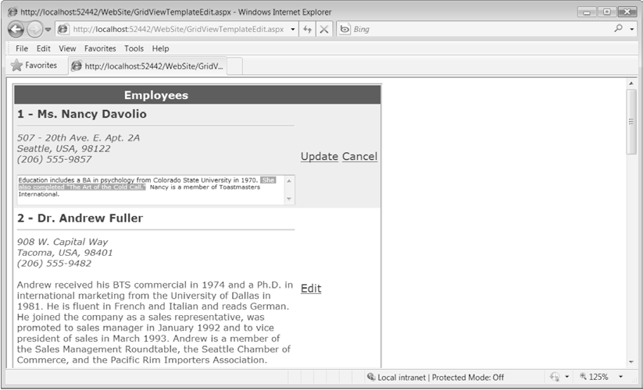
Editing with a template

Slide 45
Editing with Advanced Controls
Make the TitleOfCourtesy field editable through a drop-down list
<EditItemTemplate>
<b>
<%# Eval("EmployeeID") %> -
<asp:DropDownList runat="server" ID="EditTitle"
SelectedIndex='<%# GetSelectedTitle(Eval("TitleOfCourtesy")) %>'
DataSource='<%# TitlesOfCourtesy %>' />
<%# Eval("FirstName") %>
<%# Eval("LastName") %>
</b>
<hr />
<small><i>
<%# Eval("Address") %><br />
<%# Eval("City") %>, <%# Eval("Country") %>,
<%# Eval("PostalCode") %><br />
<%# Eval("HomePhone") %></i>
<br /><br />
<asp:TextBox Text='<%# Bind("Notes") %>' runat="server" id="textBox"
TextMode="MultiLine" Width="413px" />
</small>
</EditItemTemplate>

Slide 46
Set the DropDownList.DataSource with a data binding expression that points to a custom property
Protected ReadOnly Property TitlesOfCourtesy() As String()
Get
Return New String() {"Mr.", "Dr.", "Ms.", "Mrs."}
End Get
End Property

Slide 47
Binds the SelectedIndex to a custom method that takes the current title and returns the index of that value
Protected Function GetSelectedTitle(ByVal title As Object
) As Integer
Return Array.IndexOf(TitlesOfCourtesy, title.ToString())
End Function

Slide 48
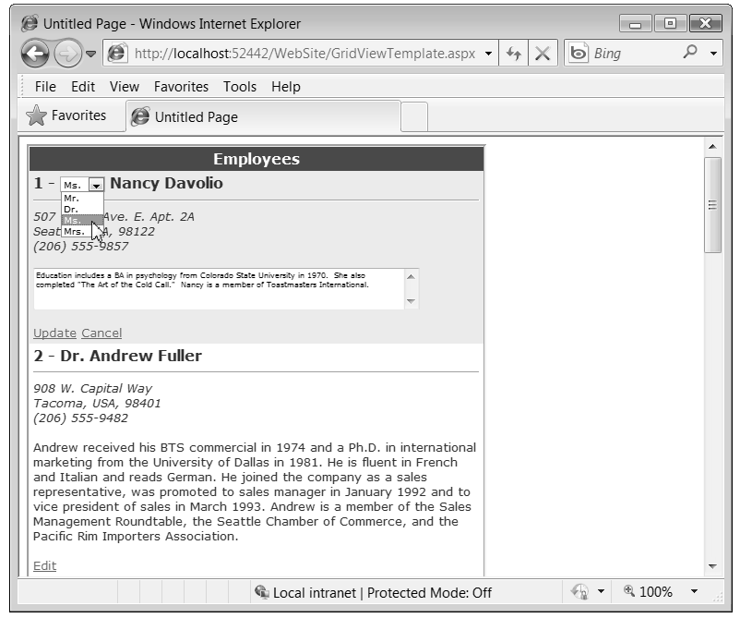
Editing with a drop-down list of values

Slide 49
Handle the RowUpdating event, find the list control in the current row, and extract the text
Protected Sub gridEmployees_RowUpdating(ByVal sender As Object, ByVal e As System.Web.UI.WebControls.GridViewUpdateEventArgs
) Handles gridEmployees.RowUpdating
' Get the reference to the list control.
Dim title As DropDownList =
DirectCast((gridEmployees.Rows(e.RowIndex).FindControl("EditTitle")),DropDownList)
' Add it to the parameters.
e.NewValues.Add("TitleOfCourtesy", title.Text)
End Sub
The UpdateCommand in the SqlDataSource must also be updated to use the @TitleOfCourtesy parameter
UpdateCommand="UPDATE Employees SET Notes=@Notes, TitleOfCourtesy=@TitleOfCourtesy WHERE EmployeeID=@EmployeeID"

Slide 50
Editing Without a Command Column
Add a button control to the ItemTemplate and set the CommandName to Edit
<ItemTemplate>
<b>
<%# Eval("EmployeeID") %> - <%# Eval("TitleOfCourtesy") %>
<%# Eval("TitleOfCourtesy") %> <%# Eval("FirstName") %>
<%# Eval("LastName") %>
</b>
<hr />
<small><i>
<%# Eval("Address") %><br />
<%# Eval("City") %>, <%# Eval("Country") %>,
<%# Eval("PostalCode") %><br />
<%# Eval("HomePhone") %></i>
<br /><br />
<%# Eval("Notes") %>
<br /><br />
<asp:LinkButton runat="server" Text="Edit"
CommandName="Edit" ID="cmdEdit" />
</small>
</ItemTemplate>

Slide 51
Need to have two a button with a CommandName of Update and another button with a CommandName of Cancel in the EditItemTemplate.
<EditItemTemplate>
<b>
<%# Eval("EmployeeID") %> -
<asp:DropDownList runat="server" ID="EditTitle"
SelectedIndex='<%# GetSelectedTitle(Eval("TitleOfCourtesy")) %>'
DataSource='<%# TitlesOfCourtesy %>' />
<%# Eval("FirstName") %>
<%# Eval("LastName") %>
</b>
<hr />
<small><i>
<%# Eval("Address") %><br />
<%# Eval("City") %>, <%# Eval("Country") %>,
<%# Eval("PostalCode") %><br />
<%# Eval("HomePhone") %></i>
<br /><br />
<asp:TextBox Text='<%# Bind("Notes") %>' runat="server" id="textBox"
TextMode="MultiLine" Width="413px" />
<br /><br />
<asp:LinkButton runat="server" Text="Update"
CommandName="Update" ID="cmdUpdate" />
<asp:LinkButton runat="server" Text="Cancel"
CommandName="Cancel" ID="cmdCancel" />
</small>
</EditItemTemplate>

Slide 52
Client IDs in Templates
Set ClientIDMode for the GridView to be predictable
Use the ClientIDRowSuffix to choose a data field for the suffix
<asp:GridView ID="gridEmployees" runat="server" ...
ClientIDMode="Predictable" ClientIDRowSuffix="EmployeeID">
…
<asp:LinkButton runat="server" Text="Edit" CommandName="Edit" ID="cmdEdit" />
…
ASP.NET generates an anchor like this:
<a id="gridEmployees_cmdEdit_45HJ77" href="javascript:__doPostBack(...)">Edit</a>

Slide 53
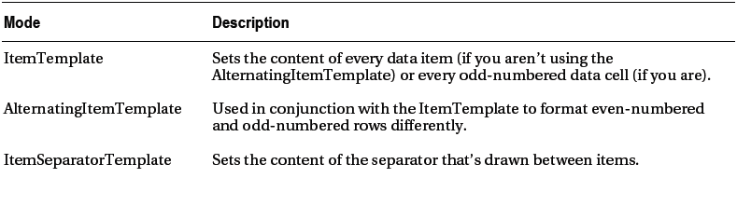
The ListView
Includes a more extensive set of templates than the GridView
ListView templates

Slide 54
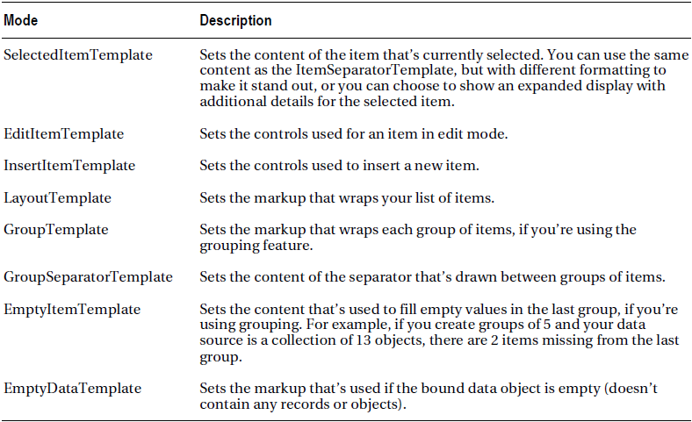
ListView templates

Slide 55
ItemTemplate
Need the ItemTemplate at a minimum
Iterates over the bound data and renders the ItemTemplate for each item.
It places all of this content inside an ordinary <span>

Slide 56
ItemTemplate
<asp:ListView ID="listEmployees" DataSourceID="sourceEmployees" runat="server">
<ItemTemplate>
<span>
<b>
<%# Eval("EmployeeID") %> -
<%# Eval("TitleOfCourtesy") %> <%# Eval("FirstName") %>
<%# Eval("LastName") %>
</b>
<hr />
<small>
<i><%# Eval("Address") %><br />
<%# Eval("City") %>, <%# Eval("Country") %>,
<%# Eval("PostalCode") %><br />
<%# Eval("HomePhone") %></i>
<br /><br />
<%# Eval("Notes") %>
<br /><br />
</small>
</span>
</ItemTemplate>
</asp:ListView>

Slide 57
Use LayoutTemplate to get more control over the arrangement of items
Indicate where the ItemTemplate content should be inserted when creating the LayoutTemplate for a ListView by adding a placeholder
Set an intem’s ID to itemPlaceholder to designate the element as the placeholder
For example, to place each item in a separate row (as the GridView does), use a table row (the <tr> element) for the item placeholder
<LayoutTemplate>
<table border="1">
<tr id="itemPlaceholder" runat="server" />
</LayoutTemplate>

Slide 58
Grouping
Set the GroupItemCount property, which determines the number of data items in each group
<asp:ListView ID="listEmployees" GroupItemCount="3" ... >
Change the ID from itemPlaceholder to groupPlaceholder
<LayoutTemplate>
<table border="1">
<tr id="groupPlaceholder" runat="server">
</LayoutTemplate>
Supply a GroupTemplate, which is used to wrap each group.
The GroupTemplate must provide the item placeholder that was formerly in the LayoutTemplate.
<GroupTemplate>
<tr><td runat="server" id="itemPlaceholder" valign="top" /></GroupTemplate>

Slide 59
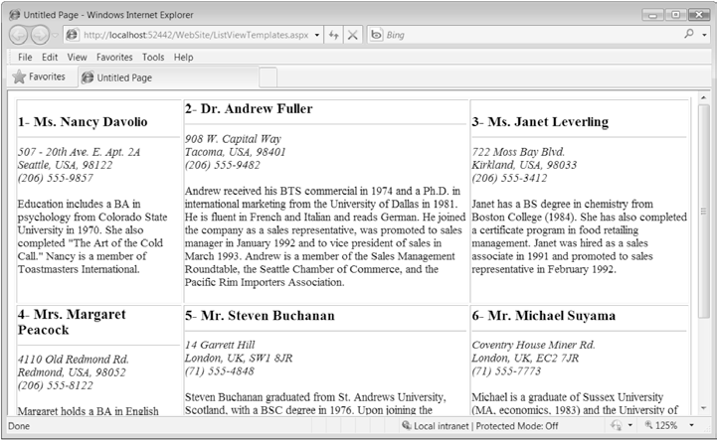
Group placeholder and the item placeholder need to be server controls, and they need to be content elements
A ListView with grouping

Slide 60
Paging
Doesn’t have a hard-wired paging feature
Rely on the supports from another control like DataPager for paging
Example of DataPager that is put at the bottom of the ListView, and is given buttons for moving forward or backward one page at a time or jumping straight to the first or last page
<LayoutTemplate>
<table id="groupPlaceholder" runat="server">
<asp:DataPager runat="server" ID="ContactsDataPager" PageSize="6">
<Fields>
<asp:NextPreviousPagerField
ShowFirstPageButton="true" ShowLastPageButton="true"
FirstPageText="|&lt;&lt; " LastPageText=" &gt;&gt;|"
NextPageText=" &gt; " PreviousPageText=" &lt; " />
</Fields>
</asp:DataPager>
</LayoutTemplate>

Slide 61
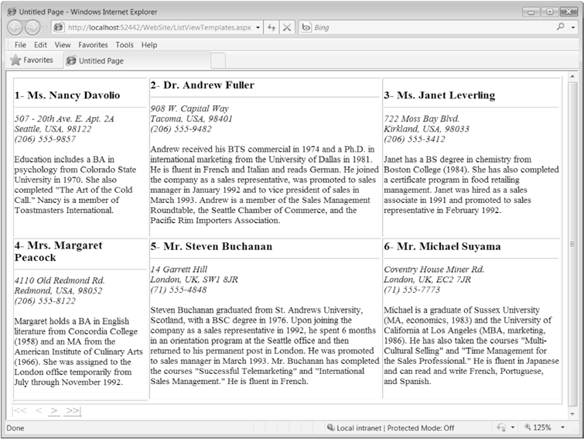
A ListView and DataPager working in conjunction

Slide 62
The DetailsView and FormView
Both show a single record at a time but can include optional pager buttons for stepping through a series of records (showing one per page)
Differences between DetailsView and FormView:-
Both support templates, but the FormView requires them
DetailsView renders its content inside a table, while the FormView gives the flexibility to display the content without a table
FormView gives the most flexibility if templates are used
DetailsView gives a simpler model to build a multirow data display out of field objects

Slide 63
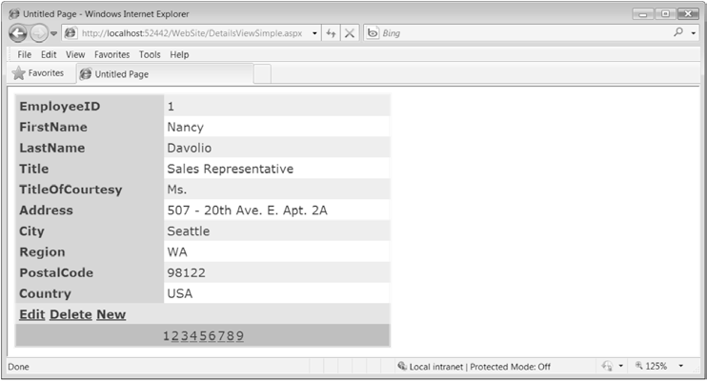
The DetailsView
Is designed to display a single record at a time
Each piece of information is placed in a separate row of a table
The DetailsView with paging

Slide 64
Defining Fields
Can disable automatic field generation by setting AutoGenerateRows to false
Field objects used to build a DetailsView and a GridView are the same
Example
<asp:DetailsView ID="DetailsView1" runat="server" DataSourceID="sourceEmployees"
AutoGenerateRows="False">
<Fields>
<asp:BoundField DataField="EmployeeID" HeaderText="EmployeeID" />
<asp:BoundField DataField="FirstName" HeaderText="FirstName" />
<asp:BoundField DataField="LastName" HeaderText="LastName" />
<asp:BoundField DataField="Title" HeaderText="Title" />
<asp:BoundField DataField="TitleOfCourtesy" HeaderText="TitleOfCourtesy" />
<asp:BoundField DataField="BirthDate" HeaderText="BirthDate" />
...
</Fields>
...
</asp:DetailsView>
DetailsView also uses a similar set of styles, events, and editing model as GridView

Slide 65
Record Operations
DetailsView supports delete, insert, and edit operations
Don’t need to add a CommandField with edit controls
Set the Boolean AutoGenerateDeleteButton, AutoGenerateEditButton, and AutoGenerateInsertButton properties on the DetailsView control
The delete operation is performed immediately when the Delete button is clicked
The DetailsView changes into edit or insert mode when the Edit or Insert button is clicked
DetailsView has three modes; ReadOnly, Edit, and Insert
Use CurrentMode property to determine the current mode
Call ChangeMode() to change the current mode
Use the DefaultMode property to set the default mode

Slide 66
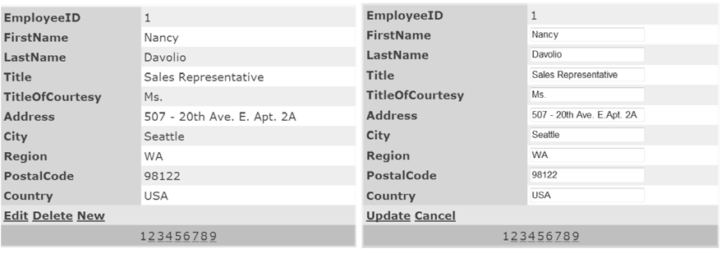
Editing in the DetailsView

Slide 67
The FormView
FormView provides a template-only control for displaying and editing a single record
Templates available:-
ItemTemplate
EditItemTemplate
InsertItemTemplate
FooterTemplate
HeaderTemplate
EmptyDataTemplate
PagerTemplate
Three distinct modes: read-only, insert, and edit
Unlike the DetailsView and the GridView, the FormView control doesn’t support the CommandField class that automatically creates editing buttons
Add a Button or LinkButton control and set its CommandName property to the appropriate value
For example, a Button with a CommandName set to Edit switches the FormView into edit mode

Slide 68
Detecting Concurrency Conflicts
Developers often use match-all or timestamp-based concurrency
UPDATE statement must match every value from the original record, or the update won’t be allowed to continue
UPDATE Shippers SET CompanyName=@CompanyName, Phone=@Phone
WHERE ShipperID=@original_ShipperID AND CompanyName=@original_CompanyName
AND Phone=@original_Phone"

Slide 69
Need to at least check for lost updates
Handling the RowUpdated event of the GridView control, or the ItemUpdated event of the DetailsView, FormView, or ListView controls
Check the AffectedRows property of the appropriate EventArgs object (such as GridViewUpdatedEventArgs)
Example that checks for a failed update in the DetailsView control
Protected Sub DetailsView1_ItemUpdated(
ByVal sender As Object, ByVal e As DetailsViewUpdatedEventArgs
)
If e.AffectedRows = 0 Then
lblStatus.Text = "A conflicting change has already been made to this " &
"record by another user. No records were updated."
End If
End Sub

Slide 70
Ideally, the page would show the current value of the record (taking any recent changes into account) and allow the user to apply the original edited values, cancel the update, or make additional refinements and then apply the update

Slide 71
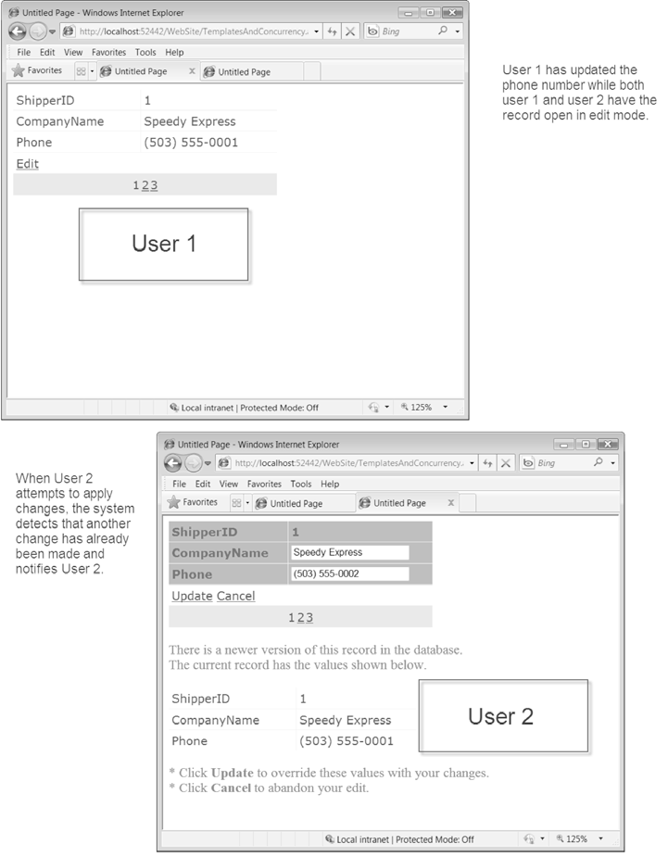
Detecting a concurrency error during an edit

Slide 72
Abbreviated definition of the DetailsView
<asp:DetailsView ID="detailsEditing" runat="server"
DataKeyNames="ShipperID" AllowPaging="True" AutoGenerateRows="False"
DataSourceID="sourceShippers" OnItemUpdated="DetailsView1_ItemUpdated" ...>
<Fields>
<asp:BoundField DataField="ShipperID" ReadOnly="True" />
<asp:BoundField DataField="CompanyName" />
<asp:BoundField DataField="Phone" />
<asp:CommandField ShowEditButton="True" />
</Fields>
...
</asp:DetailsView>

Slide 73
Data source control that’s bound to the DetailsView
<asp:SqlDataSource ID="sourceShippers" runat="server"
ConnectionString="<%$ ConnectionStrings:Northwind %>"
SelectCommand="SELECT * FROM Shippers" UpdateCommand="UPDATE Shippers SET
CompanyName=@CompanyName, Phone=@Phone WHERE ShipperID=@original_ShipperID AND
CompanyName=@original_CompanyName AND Phone=@original_Phone"
ConflictDetection="CompareAllValues" OldValuesParameterFormatString="original_{0}">
<UpdateParameters>
<asp:Parameter Name="CompanyName" />
<asp:Parameter Name="Phone" />
<asp:Parameter Name="original_ShipperID" />
<asp:Parameter Name="original_CompanyName" />
<asp:Parameter Name="original_Phone" />
</UpdateParameters>
</asp:SqlDataSource>

Slide 74
The code that catches all failed updates and explicitly keeps the DetailsView in edit mode
Protected Sub DetailsView1_ItemUpdated(ByVal sender As Object, ByVal e As DetailsViewUpdatedEventArgs
)
If e.AffectedRows = 0 Then
'lblStatus.Text = "No records were updated."
e.KeepInEditMode = True
...
' Allow more editing.
detailsEditing.DataBind()
...

Slide 75
To maintain the values that the user is trying to apply
...
' Re-populate DetailsView with values entered by user
Dim t As TextBox
t = DirectCast(detailsEditing.Rows(1).Cells(1).Controls(0), TextBox)
t.Text = DirectCast(e.NewValues("CompanyName"), String)
t = DirectCast(detailsEditing.Rows(2).Cells(1).Controls(0), TextBox)
t.Text = DirectCast(e.NewValues("Phone"), String)
...

Slide 76
List the current values in a label or another control
...
' Show the panel with errors.
ErrorPanel.Visible = True

Slide 77
A second DetailsView that binds to the matching row to show the current value of the record in question
<asp:Panel ID="ErrorPanel" runat="server" Visible="False" EnableViewState="False">
There is a newer version of this record in the database.<br />
The current record has the values shown below.<br />
<br />
<asp:DetailsView ID="detailsConflicting" runat="server"
AutoGenerateRows="False" DataSourceID="sourceUpdateValues" ...>
<Fields>
<asp:BoundField DataField="ShipperID" />
<asp:BoundField DataField="CompanyName" />
<asp:BoundField DataField="Phone" />
</Fields>
...
</asp:DetailsView>
<br />
* Click <b>Update</b> to override these values with your changes.<br />
* Click <b>Cancel</b> to abandon your edit.</span>&nbsp;
<asp:SqlDataSource ConnectionString="<%$ ConnectionStrings:Northwind %>"
ID="sourceUpdateValues" runat="server"
SelectCommand="SELECT * FROM Shippers WHERE (ShipperID = @ShipperID)"
OnSelecting="SqlDataSource2_Selecting">
<SelectParameters>
<asp:ControlParameter ControlID="detailsEditing" Name="ShipperID"
PropertyName="SelectedValue" Type="Int32" />
</SelectParameters>
</asp:SqlDataSource>
</asp:Panel>

Slide 78
The code reacts to the SqlDataSource.Selecting event for the second SqlDataSource control (sourceUpdateValues) and cancels the query if the error panel isn’t currently visible.
Protected Sub SqlDataSource2_Selecting(
ByVal sender As Object, ByVal e As SqlDataSourceSelectingEventArgs
)
If Not ErrorPanel.Visible Then
e.Cancel = True
End If
End Sub

